Slide 1

Mark Redden
Richard Chatterton

Slide 2
Design Specifications
Print all vehicles
Print all vehicles by type
Print how many vehicles are available by type
Prices for vehicles, companies
Error checking for insufficient funds
Transactions, balances, customer info
Error checking for funding

Slide 3
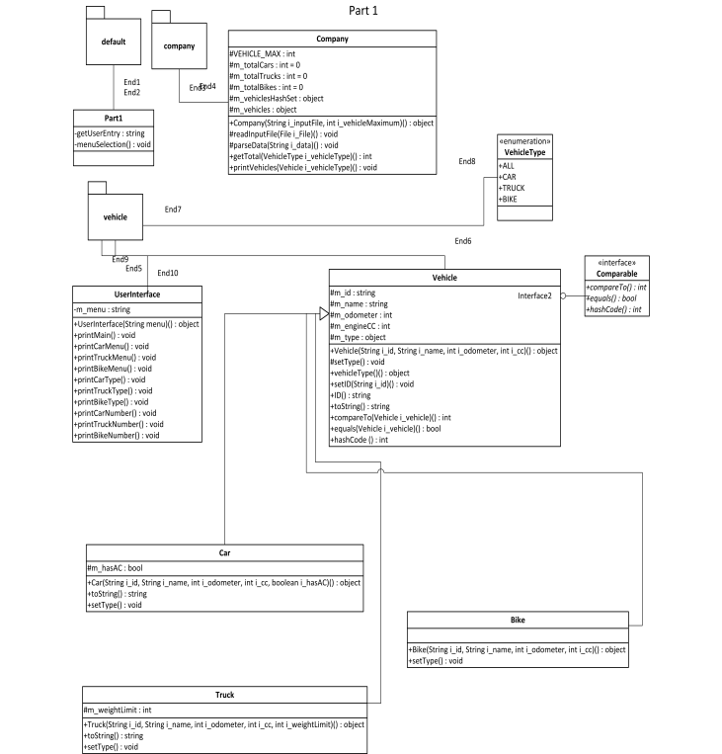
Design Specifications
Part 1 description
Object Model
Car Rental Company to display available vehicles and their attributes
Part 1
Design vehicle types
Cars, Trucks, Bikes
Design vehicle attributes
Weight limitations, A/C
Print out info for customer

Slide 4
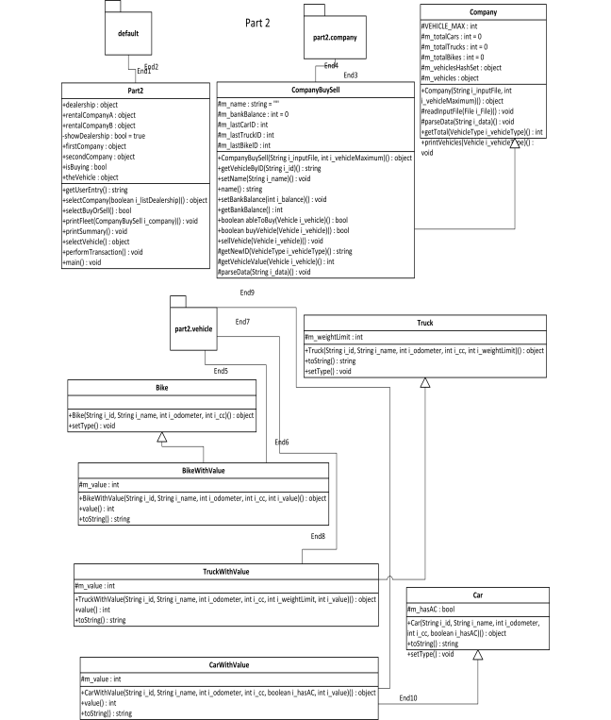
Design Description (cont.)
Part 2
Object Model
Car Rental Company to display available vehicles, company availability, prices
Part 2 (expanding from part 1 design)
Prices for each vehicle
Balance for each vehicle company
Keeping a correct balance for each company based on vehicle transactions
Making sure no vehicle availability limits are exceeded nor balances “unrealistic”

Slide 5
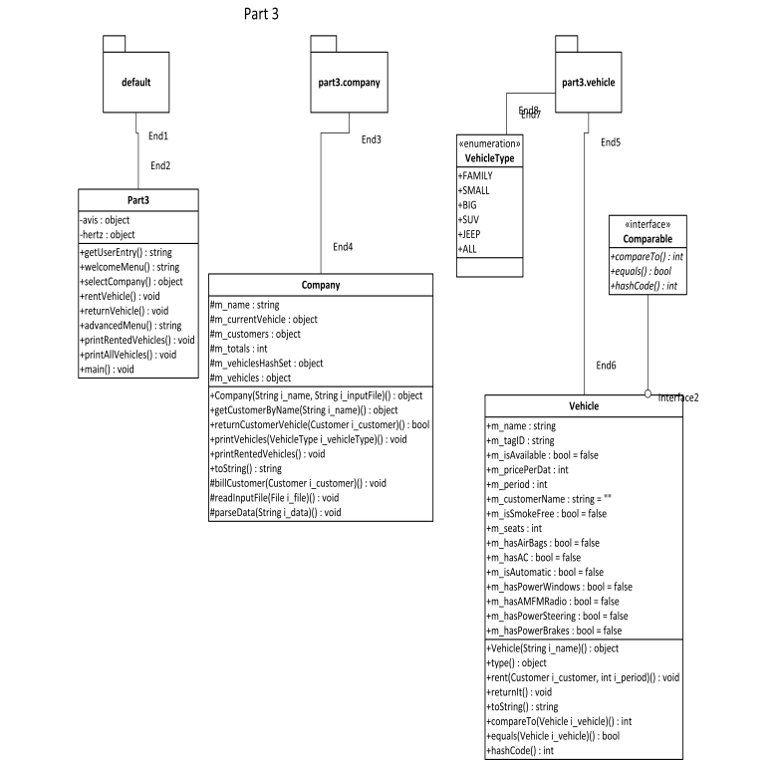
Design Specifications (cont.)
Part 3
Object Model
Car Rental Company to display available vehicles, based on purchase/rental transactions
Part 3 (expanded from part 2)
Ability to rent vehicles from companies (optional dealership field)
Defined rental periods

Slide 6
Environmental Specification
Deployment
Car rental company
Expected usage pattern: customers renting cars, companies selling/buying vehicles from each other and other dealerships

Slide 7
Package Specification
Company
Vehicle
Keeping track of companies to buy/sell
Pivotal to customer needs
All vehicle information
All possible information customer needs to know about their purchases

Slide 8
DEMO

Slide 9

Questions?

